Slide 1
Executive Rotations Roundtable
Tuesday, May 15, 2018
Employee Services, Work-life & Leadership and Executive Development

Slide 2
Agenda
AGENDA
Opening & Welcome Remarks | Julie Brill, Group Manager, Work-Life & Leadership and Executive Development
Status of Federal Executive Rotations | Yadira Guerrero, Program Manager, Work-Life & Leadership and Executive Development
Executive Rotations Panel | Towanda Brooks, Chief Human Capital Officer, Department of Housing and Urban Development Andrea Bright, Chief Human Capital Officer, Office of Personnel Management Bonnie Doyle, Assistant Deputy Commissioner for Human Resources and Deputy Chief Human Capital Officer, Social Security Administration
ESCS Rotation Modules Showcase | Latoyia DuMont, Program Analyst, Senior Executive Resources Services (SERS) Jamal Wilson, HR Specialist, Senior Executive Resources Services (SERS)
Closing Remarks | Julie Brill, Group Manager, Work-Life & Leadership and Executive Development

Slide 3
Status of Federal Executive Rotations

Slide 4
“Rotation” Definition
Rotation Definition
A development process, involving movement to another position or an assignment, that broadens the executive’s knowledge, skill and experience in order to improve talent development, mission delivery and collaboration. A rotation must last a minimum of 120 consecutive calendar days and provide experience outside the executive’s current role.

Slide 5
Types of Rotations
Executive reassignment
Executive transfer
Developmental assignment internal to the agency
Detail or developmental assignment external to the agency
Sabbatical
Notes:
Executive reassignment
Executive transfer
Developmental assignment internal to the agency, for example to another subcomponent, functional area, or location (e.g., acting in another executive position, field executive rotating to HQ or vice versa, cross-agency working group)
Detail or developmental assignment external to the agency (e.g., Intergovernmental Personnel Act (IPA) program; temporary assignment/detail to another Federal agency or private sector where permitted by law)
Sabbatical

Slide 6
FY 2017 Total Career SES Mobility by Agency

Slide 7
FY 2017 Total Career SES Mobility by Agency (Continued)
Government-wide: 20%
NOTE: Data was collected from agencies with 20 or more SES

Slide 8
Total Percent of Career SES Reassigned – Government-wide

Slide 9
Top Agencies with Career SES Reassigned

Slide 10
Top Agencies with Career SES on Details/Acting in another SES Position

Slide 11
Government-wide Career SES Mobility
Exceeded Government-wide goal of 15% of Career SES Rotating
Limited interagency mobility
Minimal use of IPAs/Sabbaticals

Slide 12
The Talent Management and Succession Management process should inform decisions about rotations, reassignments and other executive development.

Slide 13
Annual Leadership Talent Management & Succession Planning Process (TM&SP)
Successfully forecast agency executive resources needs
Assess and develop the needs of current SES members
Create a pipeline of high-quality successors for the full range of executive positions within an organization

Slide 14
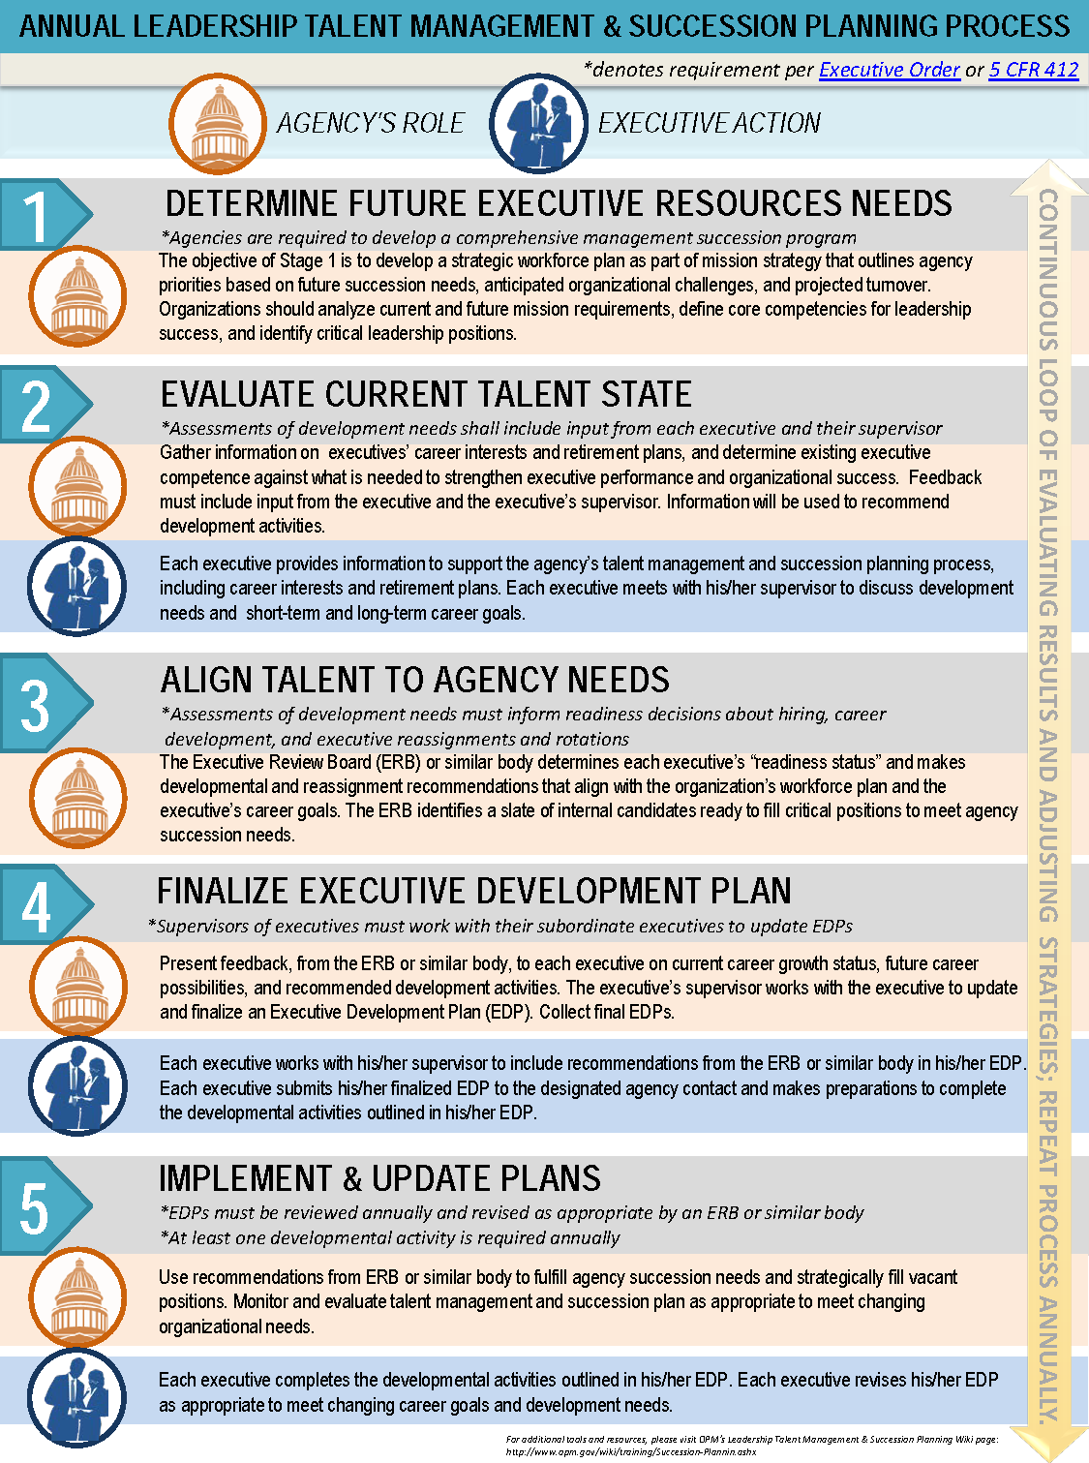
Alignment to Business Strategy
Inclusive & Holistic Development

Slide 15
Framework for the Continuing Development of Federal Senior Executives
Notes:
at each specific stage of an executive’s lifecycle of learning

Slide 16
SES Lifecycle of Learning
Key Leadership Behaviors
Developmental Objectives
Developmental Opportunities
Finding my Place
Making My Mark
Leaving My Legacy
Notes:
Leadership behaviors- Identifies characteristics necessary to achieve & sustain executive excellence?
Developmental objectives-Provides direction & focus to enhance the desired behaviors
Developmental opportunities
Identifies specific experiences to build leadership capability

Slide 17
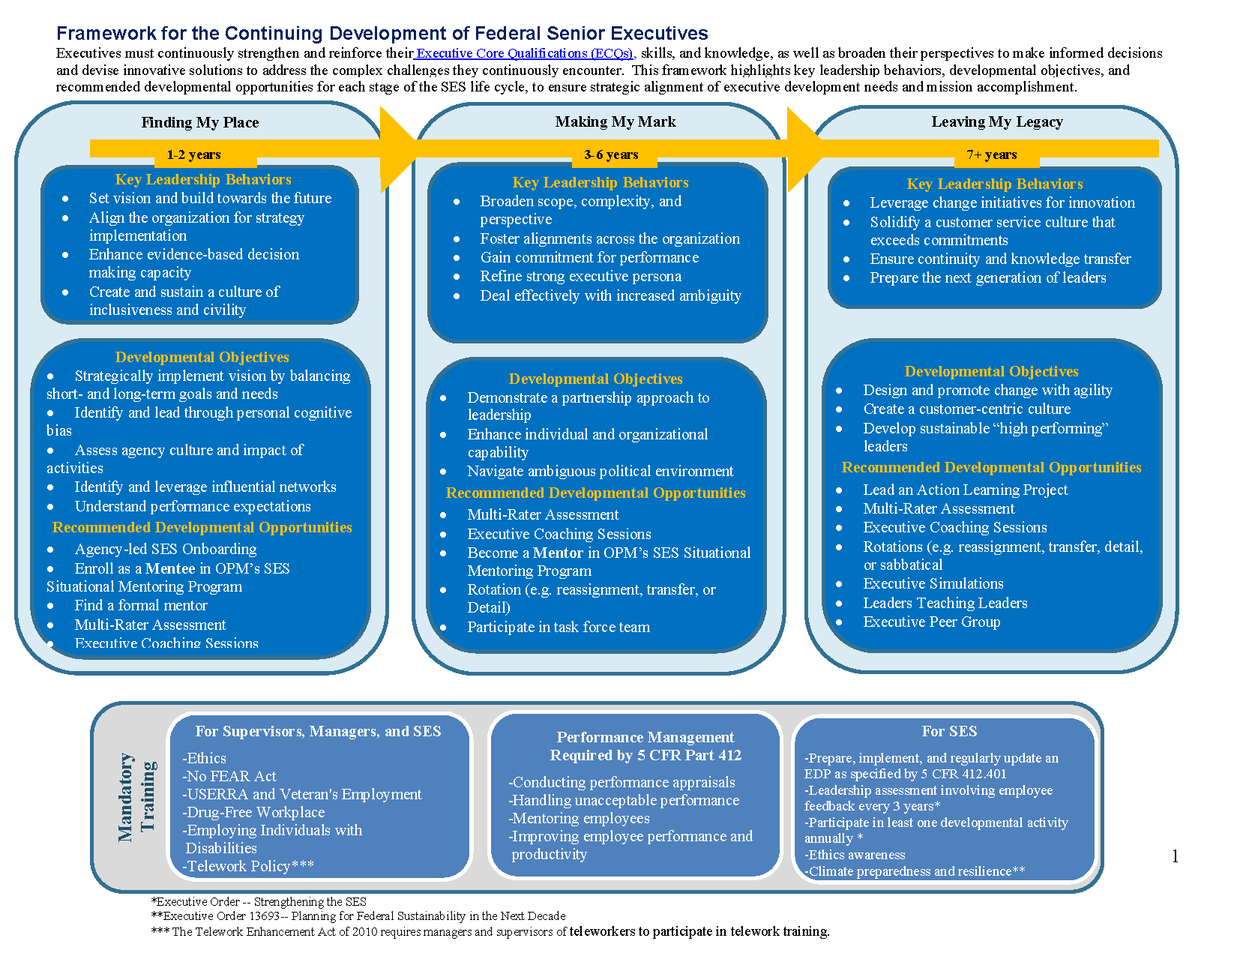
Notes:
Executives are required to complete an Executive Development Plan and update it annually. We recommend the use of the 70-20-10 model to guide the development of these plans. While it’s common to prioritize formal training, research has shown that people learn most effectively when applying their skills to on-the-job experiences. 70% of development occurs through experiences on the job, 20% through learning from others, and 10% from formal classroom training.

Slide 18
How to use the Framework
Senior leadership/ER – use in the executive development phases of the talent management & succession planning processes
Instructional designers/L&D professionals – design executive development programs & chart leadership development
Executives – assess their current state of development and create an EDP
Notes:
The framework, coupled with organizational and individual executive needs, should be used during the
Workforce analysis
Talent review meetings
Development of EDPs

Slide 19
OPM Resources and Training Solutions
Leadership Talent Management & Succession Planning Wiki Page
  https://www.opm.gov/wiki/training/Succession-Planning.ashx
ESCS Talent Management Module
Federal Coaching Network
SES Situational Mentoring Program
OPM’s Center for Leadership Development
Federal Training and Development Wiki

Slide 20
Questions?
Yadira Guerrero
Yadira.Guerrero@opm.gov
202-606-7954

Slide 21
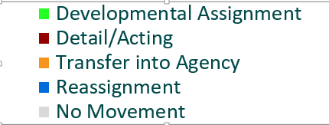
Agencies with a Strong Commitment to Executive Mobility
41%

Slide 22
Towanda Brooks
Chief Human Capital Officer, Department of Housing and Urban Development

Slide 23

U.S. Department Of Housing and Urban Development

Slide 24
2017 SES MOBILITY
31% Of Career SES at HUD were Mobilized in 2017
19% Reassignments
12% Details
Other Developmental assignments and Growth opportunities
      SES Working Groups
      Departmental Task Forces
      Hands-on Training and Development - Conferences, Forums, and Book Series
      Mentor and Mentee Program
      Coaching

Slide 25
DEVELOPMENTAL LEARNING
Close coordination between Chief Learning Officer and Executive Resources
Workforce and Succession Planning Data -
Quarterly SES & SL Forums - Learning and targeted developmental briefings for Executives
        Target Key ECQs
        Performance Management
        Leadership assessment tool (immediate results)
        Development of Executive Development Plan (EDP)
HUD LEARN played a key role in the development of our Senior Executive Service Rotational Program

Slide 26
Details and Reassignments
Develop, Refresh, and Enhance Senior Executives skills and competencies
Fulfill Agency mission requirements
        Short-term vacancies
        Projects that cross program lines
        Disaster Recovery
Fill gaps during transition times
Succession Planning - Workforce Planning at a 1 year, 3 year and 5 year look
      Develop senior executives for higher level positions
      Changing agency requirements
      Planned attrition

Slide 27
STRATEGY and Outcomes
Used the Community of Practice Methodology with Senior Executives to share the SES Rotations Program
2017 Reassignments - Filled key positions in the Agency during an immense time of transition
Major detail actions of career SES to the highest level positions in the agency - Career SES detailed to Acting Deputy Secretary (8months); Career SES Acting Secretary - 3 months;
SES Working Group - Reviewed the SES Performance Management, Performance Review Process, Trainings needed and required of Senior Executives, and made recommendations

Slide 28
HUD SENIOR EXECUTIVES
Office of Executive Resources is creating an updated resource document with Senior Executives by Program Office -
      Goal is to have updated resumes FY2018 Q4 - FY 2019 Q1
      Updated SES/SL data on HC dashboard
      Options for filling vacancies - Details, Rotations, Reassignments, Transfers, Hires
Closely tracking current Agency Vacancies and needs
Leadership Development Opportunities - HUD LEARN and OER Joint Collaboration
      OCHCO Project Team - 2018 Q1 Excellence Leadership Conference
      SES Orientation and On-Boarding - Refresh and Update (Q3-Q4 2018)
Use Information gained from PRBs, SES Working Groups, implementation of Rotations Program, On-Boarding Program, SES Development Cohort Program, SES Forums, and Updating of Organizations’ Position Descriptions to Improve on HUD’s ability to have an Effective Leadership Cadre
Expanded use of Coaching Program

Slide 29
Andrea Bright
Chief Human Capital Officer, Office of Personnel Management

Slide 30
Bonnie Doyle
Assistant Deputy Commissioner for Human Resources & Deputy Chief Human Capital Officer, Social Security Administration

Slide 31


Social Security Administration
Executive Rotations

Slide 32

Questions?

Slide 33
ESCS Rotation Modules Showcase

